Slide 1
The Scatter
The Scatter

Slide 2
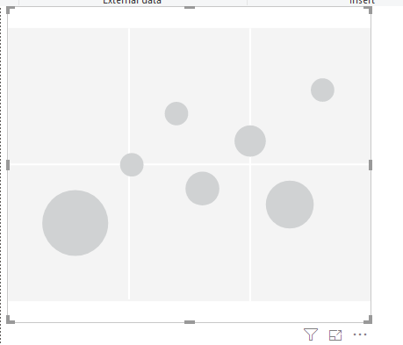
The Scatter
Note: The data is from AdventureWorksDW2016 database
Add a Scatter Visual to Scene Level

Slide 3
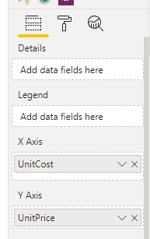
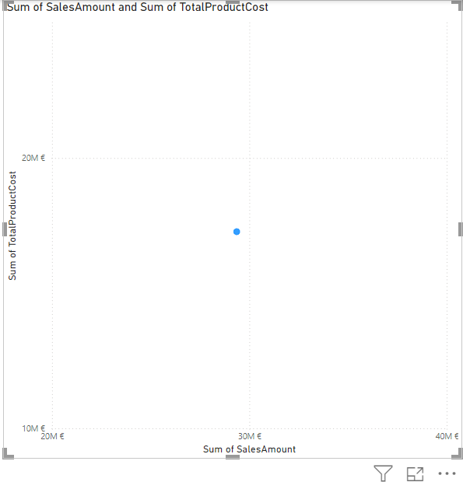
The Scatter
To use the Scatter, you need to have two variables or two measures to use in this case it is SalesAmount and TotalProductCost from the FactInternetSales table we add them respectively at the X and Y axes

Slide 4
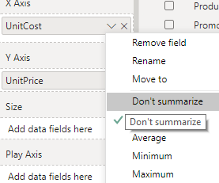
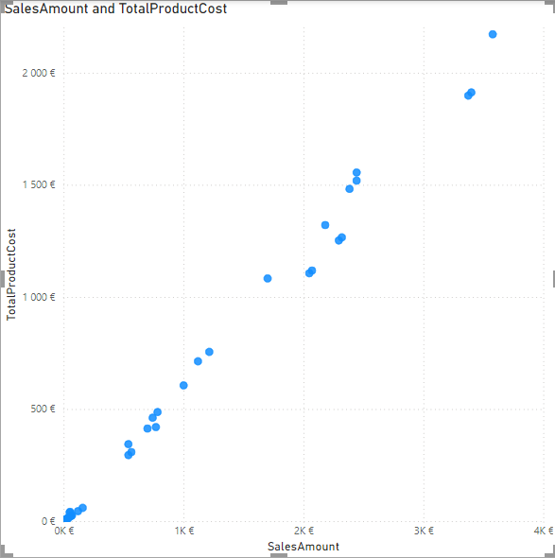
The Scatter
You need to disable aggregation for one or both measures to get the figure below

Slide 5
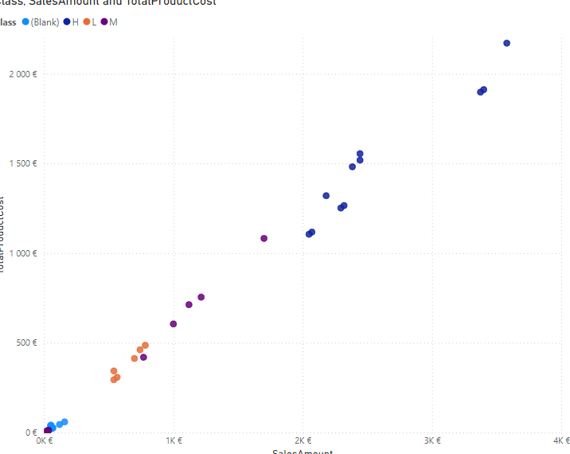
The Scatter
Note that the reading of the data is still not conclusive.
Add Class from DimProduct table to Legend level and aggregate both measures again

Slide 6
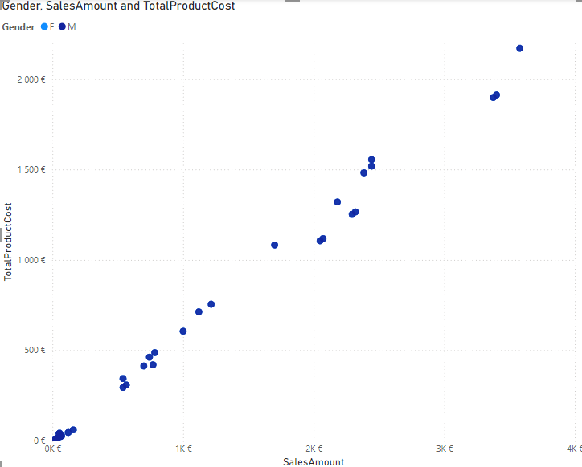
The Scatter
Substitute Class from DimProduct with Gender from the DimCustomer table and observe especially the outliers

Slide 7
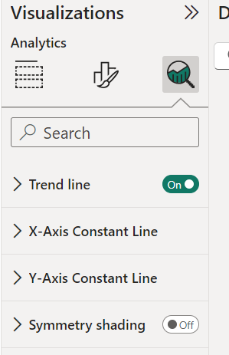
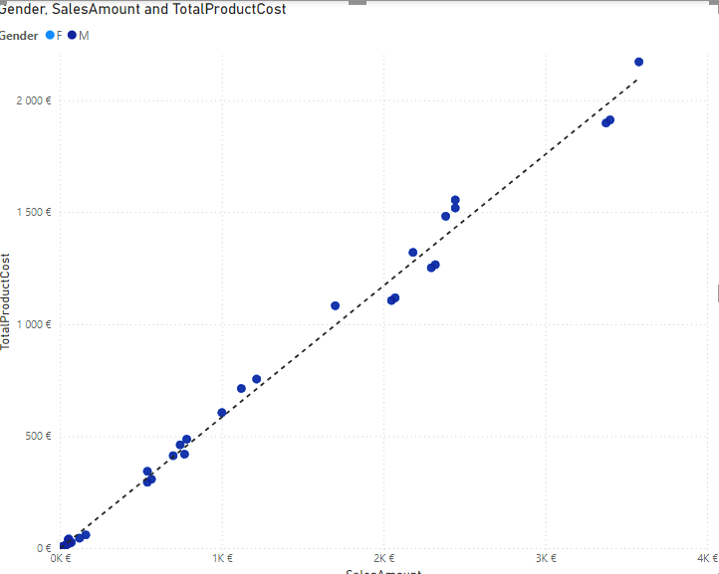
The Scatter
Try to activate Trend line from Analytics

Slide 8
Thank you
Thank you

